Slide 1



























TR
ed La ce
TAINABILITY
TEAM : CASEMATES
IPUR

Slide 2
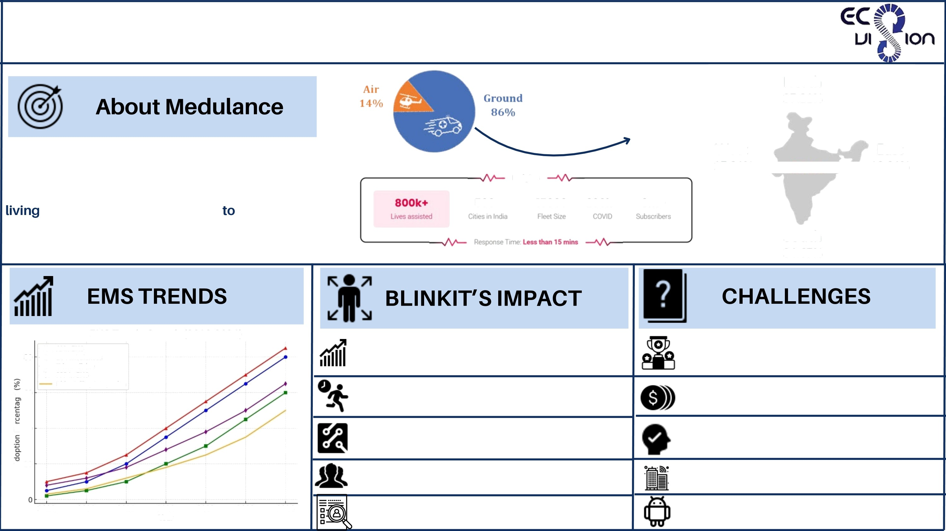

OVERVIEW& CHALLENGES
Preferrable mode of transport for ambulance services
North
37.21⁰6
India's first, GPS based technology platform for fast and reliable first point medical attention. With an increasing emphasis on promoting independent
West
17.21%
East
10.91%
. . ’2022
insights
today, having access the nearest ambulance to you can provide much needed peace of mind in a worst case scenario.
b0oe
fb0oo
2ooke 8m+
South
34.67%
EMS Trends Growth (2018-2024)
80
Al in EMS
EV Ambulances
Telemedicine
PPP in EMS
Ride-Hailing Integration
Increased Competition for Medulance
Intense Competition
qj 60
Hypertocal Logistics Strength
High operational Cost
m 40
Technological Upgrade in EMS
Slow Government Approvals
Extensive Delivery Network
Infrastructure Limitations
2018
2019
2020
2021
Year
2022
2023
2024
Customer Data in Medical purchase
Limited App-Driven Accessbility

Slide 3
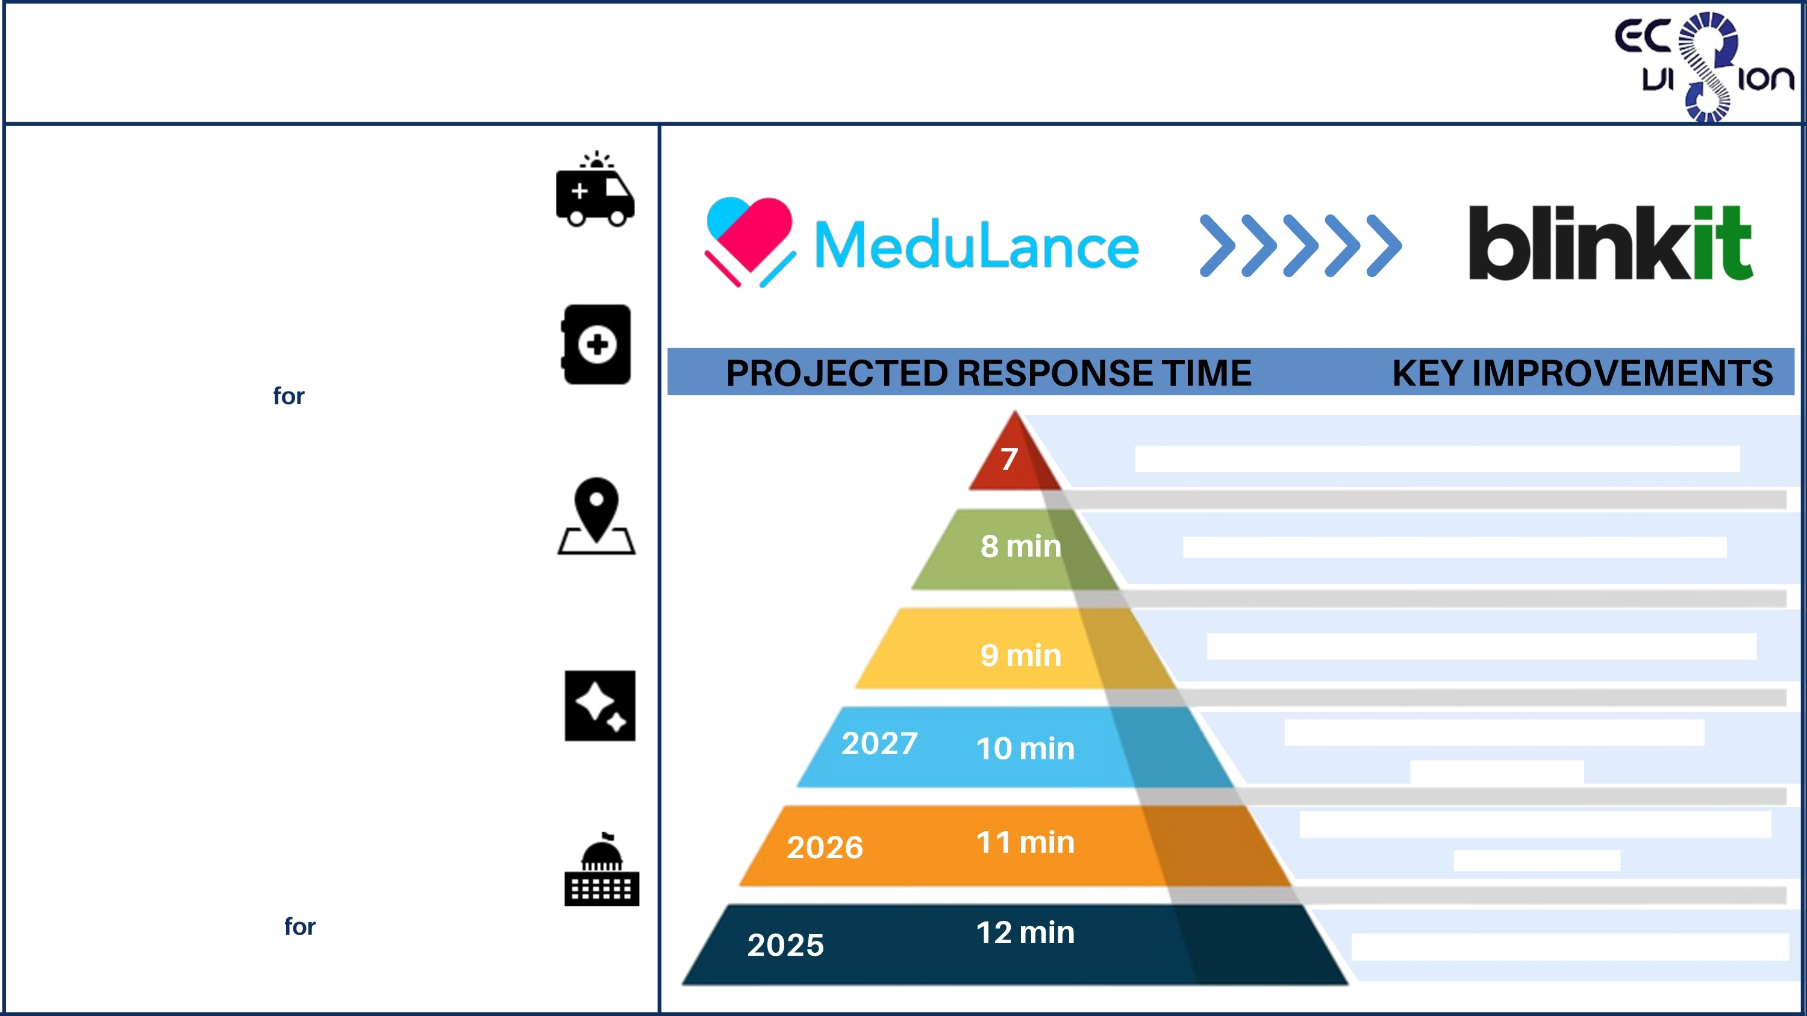
REDUCE MEDULANCE'S AMBULANCERESPONSE TIME
Micro-Hub Ambulance Stations:
We need to develop stationed ambulances that is similar to Blinkit's Hyperlocal Model.
Telemedicine Integration:
Equipped that ambulances which are having telemedicine kits remote doctor consultations before pickup of patient.
Dynamic Routing System:
We need to develop real time GPS tracking with Al driven route for route optimization to avoid traffic delays.
2030
Near-instant dispatch with predictive analytics
2029
Autonomous ambulance assistance starts
AI Powered Dispatching:
We are using Al and predictive analytics to pre-position ambulances based on historical emergency patterns.
2028
Dedicated emergency lanes in major cities
Expanded fleet and better traffic management
More EV ambulances, faster hospital coordination
Public-Private Partnerships:
Collaboration with government bodies and private hospitals shared EMS infrastructure.
AI Based dispatch fully integrated

Slide 4
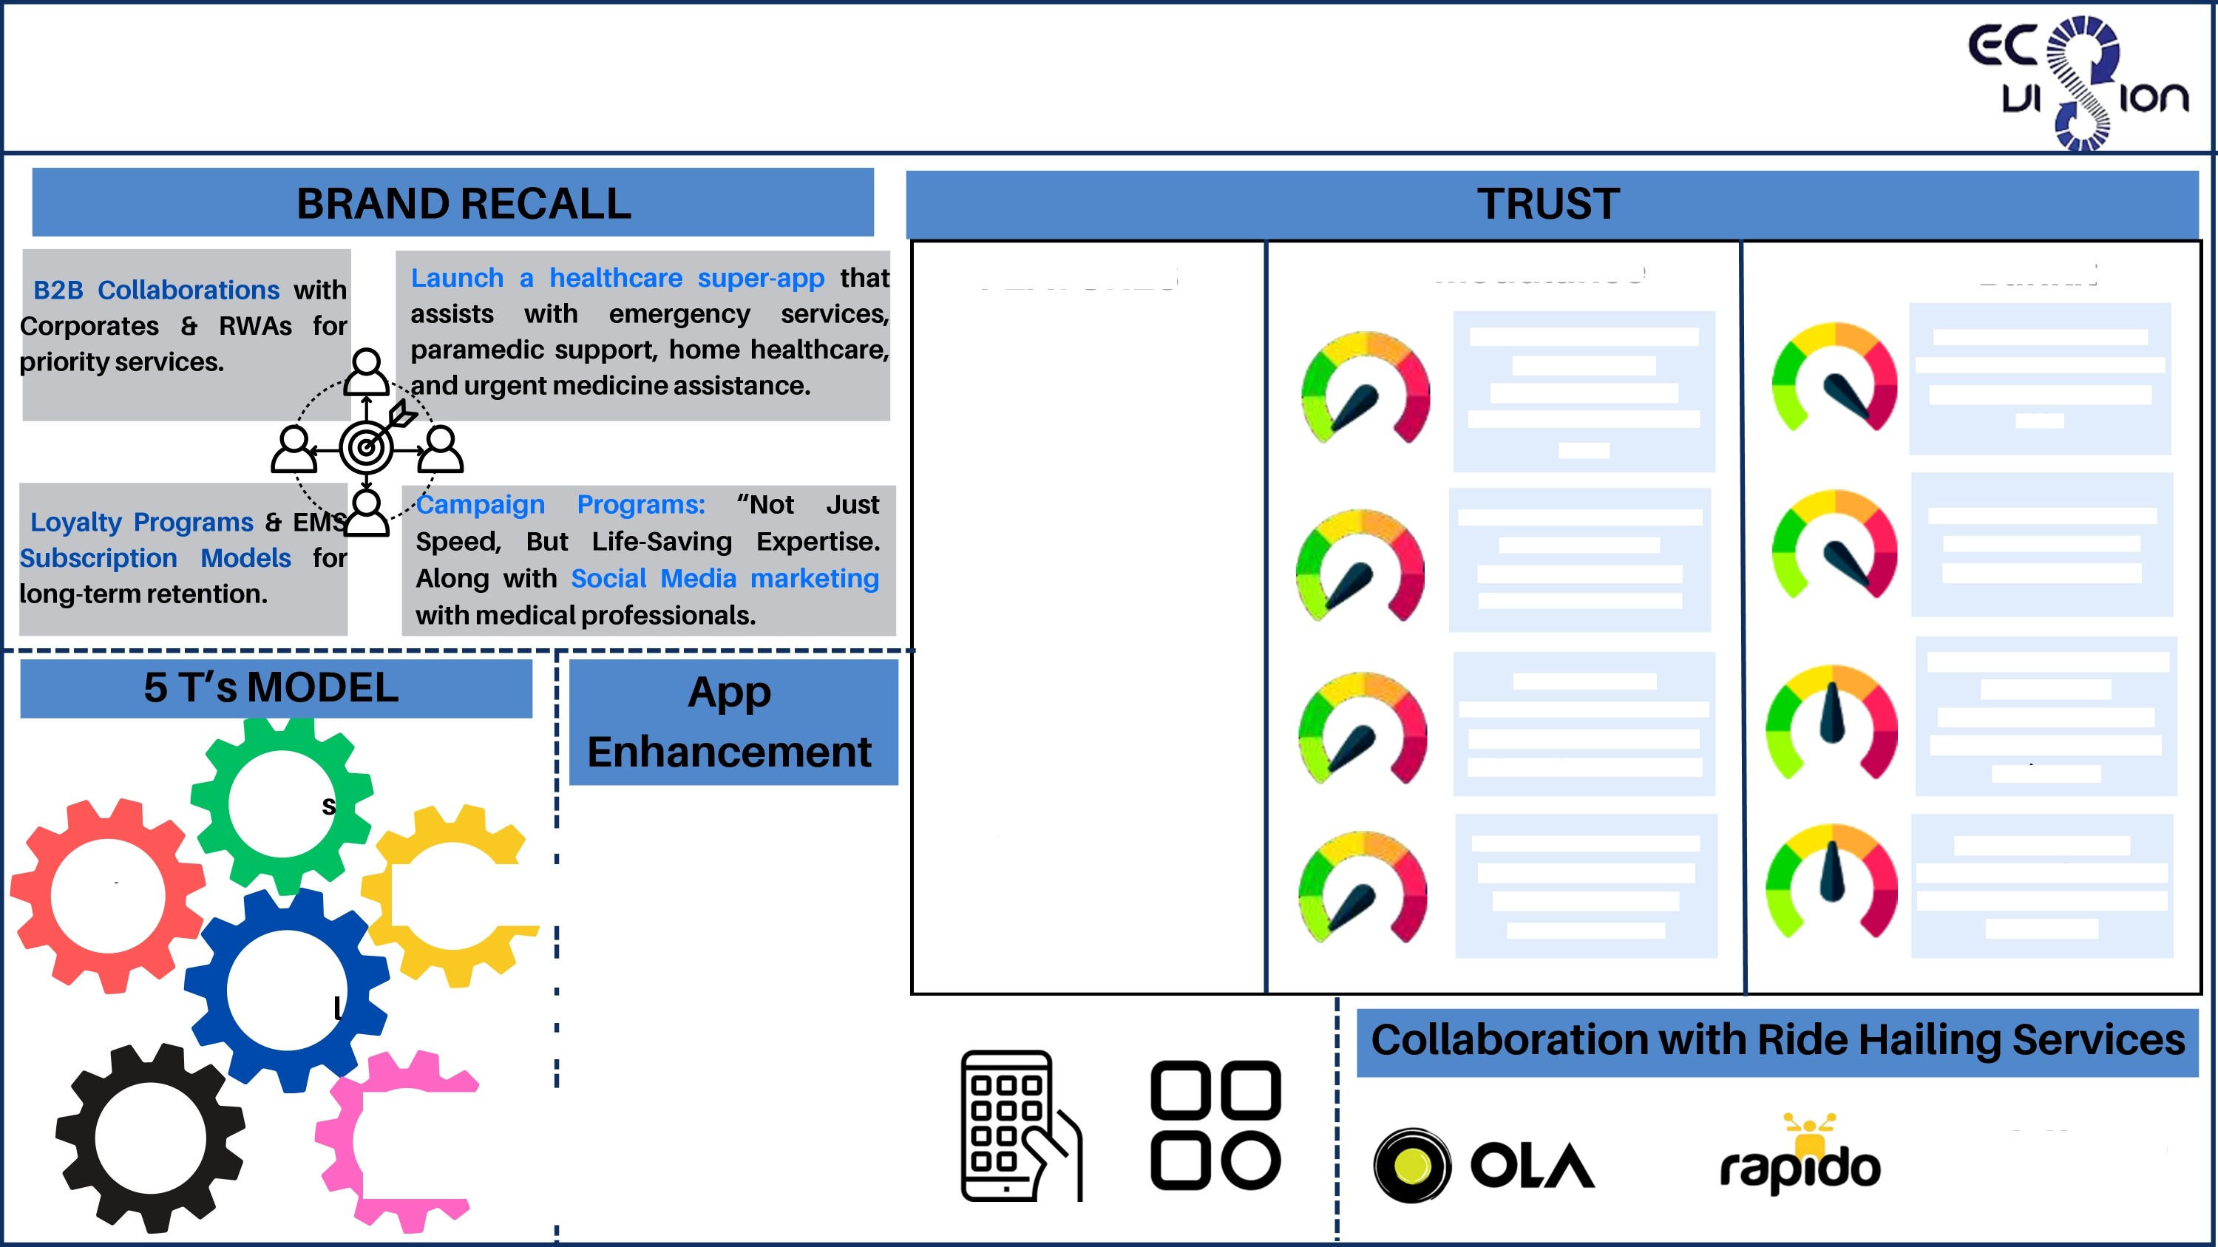




STRENGTHEN BRAND RECALL AND TRUST
FEATURES
Medulance
established in 2017, has been providing emergency medical services (EMS) for over 8 years
Blinkit
Blinkit launched its 10- minute ambulance service in Gurugram in January 2025
1.Years of Expertise
2.Integrated Emergency
Services
Medulance offers medical care services like MeduErs, MeduClinic, MeduAlert 6 MeduFit.
It does not offer services similar to Medulance except for rapid EMS.
3. Various Types of
Ambulances
Offers different ambulance services based on requirement like ALS, BLS, PTA 6 Mortuary van.
Currently offers Basic Life Support (BLS) ambulances, equipped with essential life-saving equipment.
Talker
! 1.UI/UX Improvement for
i faster access and real
time GPS tracking.
4.customer Base
Assisted over 1.5 million patients, establishing a strong reputation in emergency care.
Leverages existing customer base from quick- commerce operations, still developing.
Topics
Tracking
5 T's
Mode
! 2.Al Powered Emergency
! Prediction , personalized
! SOS triggers
_{i} 3.Seamless payment like
Uber
Tools
^{i} multiple
payment
i
^{i} options of UPI , Wallets,
i
! BNPL

Slide 5
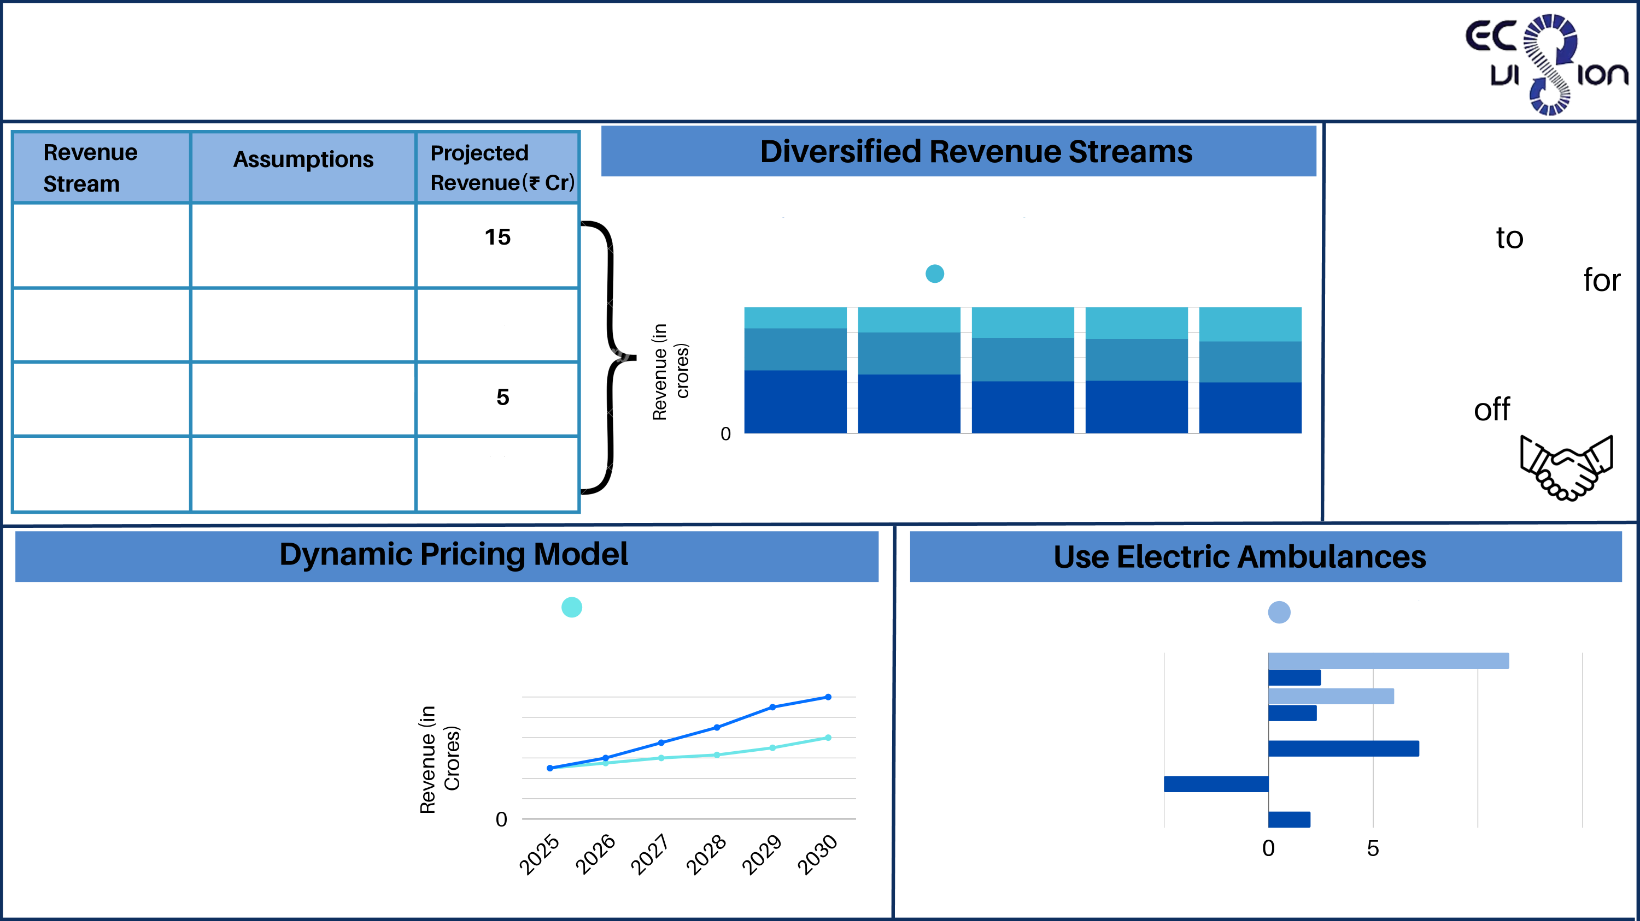
FINANCIAL SUSTAINABILITYBY OPERATIONAL
OPTIMIZATION
Cross utilisation of
ambulatnce can
happen use
ambulances
non-emergency
Subscriptions
10,000 users • T1,5OO/year
s,oOO visits/month « z1,5oo/visit
Insurers' contribution for EMS
@ Subscriptiornevenue @ Home Healthcare Revenue
lnsuranceRevenue
Home Healthcare
100
80
60
40
20
10
patient
during
hours.
transport
peak
Insurance
Total Revenue(2025)
30
2025
2026
2027
years
2028
2029
Increased price:
In peak hours
In High traffic zones
If nearby hospitals are full 4.Discounts for susbscribers
Higher for critical emergencies
Higher in extreme weather
Fixed Pricing Model
Diesel @ EV
@ Dynamic Pricing Model
Fuel/Energy Maintanance
Battery Replacement Govt. Incentives Charging Costs
120
100
80
60
40
20
-5
10
Cost (in Lakhs/Year)
15
Years

Slide 6
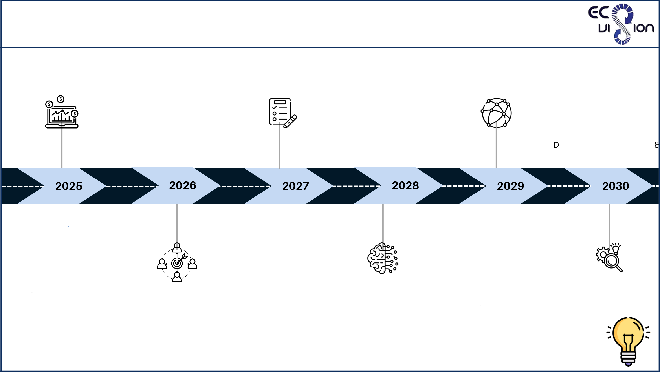
CONCLUSION & ROADMAP
Deep Tech and AI
Optimization
A smart chatbot integrated
into the SuperApp and
website
Brand Recall and Digital Ecosystem
Launch Healthcare SuperApp for orgs (EMS + paramedics + homecare)
Promote tech edge (Al dispatch,
5G ambulances, tracking)
Strengthen influencer-led branding & real-life success stories
Sustainability 6 Competitive Dominance
Set benchmark for EMS
efficiency & outcomes
Strong CSR-led campaigns for awareness
Create a Medulance Research ivision to publish EMS data
tech use cases
Integrate with smartwatches for real-time health monitoring
Uses NLP to analyze feedbacVsentiment and flags service gaps
Monetization 6 B2B Expansion
Launch subscription & EMS
loyalty plans
Begin B2B tie-ups with RWAs,
corporates
Expand home healthcare services
Initiate 2-3 insurance
partnerships
Position brand via emotional storytelling & tech innovation
Infrastructure and Pan
India Coverage
Invest in medical-
grade ambulance
fleets (ALS, BLS)
Expand to 50+ cities with zonal operational hubs
Integrate with
Ayushman Bharat &
state EMS programs
Global Standards 6 New
Revenue Channels
Gain NABH/ISO
accreditation for EMS
Launch training &
certification programs
(MeduCare Academy)
Expand MeduAlert
services
Introduce freemium models & micro-insurance EMS coverages for rural India

Slide 7


